Slide 1

Data Programming in Python _________________ For vs. While Loops

Slide 2
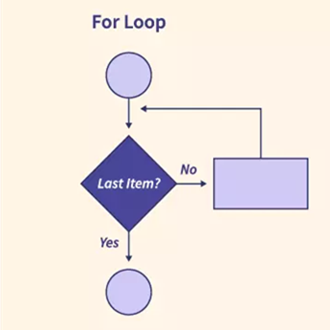
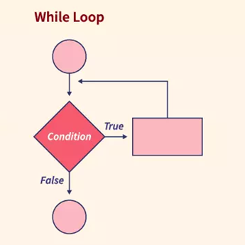
For vs. While Distinction
For loop:
Fixed iterations
Loop over collection
While loop:
Loop until condition
happens

Slide 3
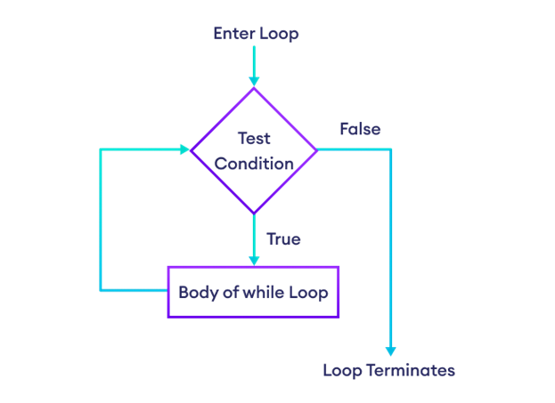
Indefinite (while) Loops
While loops continue until a T/F condition becomes False
while condition :
# body of while loop

Slide 4
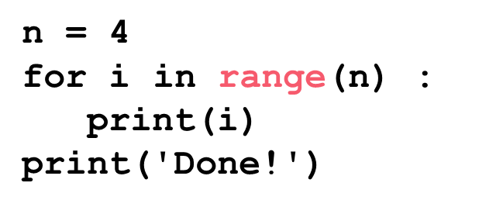
Definite (for) Loops
Loops a set number of times over a collection or range of numbers
for i in [3, 5, 10]:
print(i)

Slide 5
Using range()
range(start, stop, step)
start – first number in the sequence
stop – upper limit (won’t reach this number/goes to stop-1)
step – by how much it counts up or down

Slide 6
For vs. While Comparison
for Loops
VS while Loops
* Known number of iterations
* can end early via break
* uses an iteration variable
* can always rewrite a for loop using a while loop
* Unknown number of iterations
* can end early via break
* can use a counter, but must initialize before loop and increment it inside loop
* may not be able to rewrite a while using a for loop

